Slide 1
Semantic Networks for Knowledge Representation
Understanding Structures & Types

Slide 2
What is Semantic Network?
Semantic networks are an alternative to predicate logic for knowledge representation.
Knowledge is represented in the form of graphical networks.
The network features nodes that represent objects.
Arcs describe the relationship between these objects.
Objects can be categorized in various forms using semantic networks.
These networks can link objects together.
Semantic networks are user-friendly and easily understood.
They can be extended without much complexity.

Slide 3
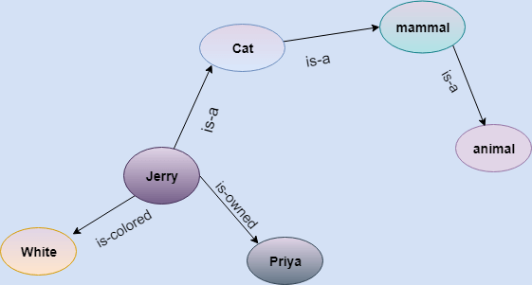
Components
Nodes (Entities):
These are the individual units or concepts within the network.
Edges (Relations):
These define the relationships or links between the nodes.

Slide 4
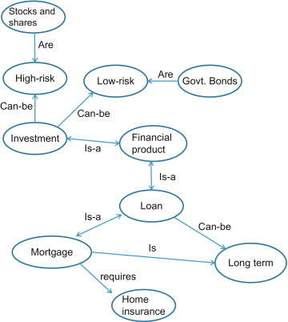
Features
Captures semantics or meaning.
Facilitates reasoning and inferencing.
Hierarchical relationships.

Slide 5
Types of Semantic Network
Definitional Networks
Assertional Networks
Hybrid Networks
Implicative Networks
Learning Networks

Slide 6
Definitional Network
A definitional network, in the context of semantic networks, focuses primarily on type/subtype relationships, often referred to as "Is-A" relationships. It deals with general knowledge about categories of things and how they relate to more general or specific categories.
Imagine a hierarchical structure. At the top, you might have the most general of categories. As you go down the hierarchy, things get more specific. The relationships primarily determine what category a specific item belongs to.

Slide 7
Example
Consider a digital library system. In this system, books are categorized based on genres, sub-genres, and themes.
Mystery is a genre.
Detective fiction is a sub-genre of mystery.
Noir is a style of detective fiction.

Slide 8
Applications
Taxonomies:
For biological classifications. For instance, "A rose is a flower," "A flower is a plant."
Digital Libraries:
As illustrated above, to categorize content hierarchically.
E-commerce:
For product categorization. "A sedan is a car," "A car is a vehicle."

Slide 9
Assertional Network
Assertional networks, in the context of semantic networks, focus on representing specific instances of entities and the relationships between them. Instead of broad category relationships (like in definitional networks), assertional networks delve into individual cases or assertions.
While definitional networks might tell you about the general relationships, assertional networks give you specifics about individual entities.

Slide 10
Example
Consider a social media platform:
Alice is friends with Bob.
Alice likes jazz music.
Bob shared a photo on Alice's timeline.
Here, "Alice" and "Bob" are specific entities (users) on the platform, and the relationships and actions between them are individual assertions.

Slide 11
Applications
Social Networks:
Mapping out relationships and interactions among users, like friendships, followers, or specific actions (e.g., likes, shares).
Personalized Recommendations:
For example, in e-commerce, if "John bought a guitar," he might be interested in guitar accessories.
Geographical Information Systems (GIS):
Mapping specific locations and their relationships, like "Restaurant A is next to Park B."

Slide 12
Hybrid Network
A hybrid network, as the name suggests, is a combination of both definitional and assertional networks. It integrates general knowledge about categories (definitional) with specific knowledge about individual entities and their relationships (assertional).
Hybrid networks essentially bridge the gap between broad classifications and individual instances, allowing for a more comprehensive representation of knowledge.

Slide 13
Example
Imagine an online movie streaming platform:
A thriller is a genre. (Definitional)
Psychological thrillers are a sub-genre of thrillers. (Definitional)
Inception is a psychological thriller. (Assertional)
User A watched Inception. (Assertional)
This platform's database uses hybrid networks to represent both the hierarchical categorization of movies and specific user interactions with those movies.

Slide 14
Applications
E-commerce Platforms:
Representing product categories and hierarchies (definitional) along with individual user purchase histories and preferences (assertional).
AI and Expert Systems:
Providing a foundational understanding of a domain (definitional) and then layering on specifics to make accurate decisions or predictions (assertional).
Educational Platforms:
Representing general knowledge about subjects or topics (definitional) and tracking individual student interactions, progress, and performance (assertional).ac

Slide 15
Implicative Network
Implicative networks in the context of semantic networks contain implication links between nodes, suggesting if one concept implies another. The edges (or links) in these networks indicate a kind of causality or a conditional relationship between nodes.
Implicative networks denote relationships where the existence or state of one node implies something about another node.

Slide 16
Example
Consider a smart home system:
If the temperature drops below 65°F, then turn on the heater.
If it's dark outside, then turn on the indoor lights.
In this smart home scenario, certain conditions or states (like the drop in temperature or darkness outside) trigger or imply specific actions (like turning on the heater or lights).

Slide 17
Applications
Expert Systems:
They help in decision-making based on a series of conditions and implications. For example, in medical diagnosis, "If symptom A and symptom B are present, then it might imply condition C."
Control Systems:
Such as the aforementioned smart home systems or industrial automation, where specific conditions imply certain actions.
Programming Logic and Algorithms:
Representing flow and decision-making based on certain conditions.

Slide 18
Learning Network
A learning network, in the context of knowledge representation, is a type of network or model that evolves and adapts based on new information or experiences. It is designed to learn and update its structure and knowledge over time.
Learning networks are different from traditional static knowledge representation models. Instead of having fixed nodes and relationships, learning networks can change their structure, add new nodes, update existing ones, or modify relationships as they acquire new data or experiences.

Slide 19
Example
Consider an email spam filter:
Initially, the filter may not know which emails are spam and which are not.
As users mark emails as spam or not spam, the filter learns from these interactions.
Over time, it updates its internal model to better identify spam based on patterns in the emails it has seen.
In this scenario, the spam filter is a learning network that adapts and improves its performance as it encounters new data.

Slide 20
Applications
Natural Language Processing (NLP):
Language models like GPT-3 use learning networks to improve their understanding and generation of human language.
Recommendation Systems:
Systems like Netflix or Amazon use learning networks to personalize recommendations based on user behavior.
Fraud Detection:
Banks and credit card companies employ learning networks to detect unusual patterns in transactions and adapt to new fraud schemes.

Slide 21
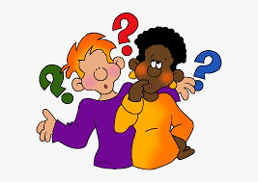
Ask Me Anything

